Slide 1



Cutting-Plane Training of Non-associative Markov Network for 3D Point Cloud Segmentation
Roman Shapovalov, Alexander Velizhev
Lomonosov Moscow State University
Hangzhou, May 18, 2011
Notes:
AV: Don’t forget to add lab’s logo

Slide 2
Semantic segmentation of point clouds
LIDAR point cloud without color information
Class label for each point
Notes:
We’ve got a point cloud from airborne laser scanner without color information as an input.
And our task is to find a class label for each data point.

Slide 3
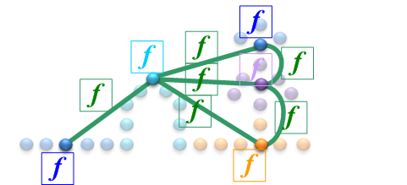

System workflow
feature computation
segmentation
CRF inference
graph construction
Notes:
AV:
Increase size of images
Image captions are not correct
“Segment structure” – I think “Oversegmentation” is better
Unary potentials – and what about pairwise ???
Where is a learning stage ???

Slide 4
Non-associative CRF
node features
edge features
point labels
Associative CRF:
Our model: no such constraints!
[Shapovalov et al., 2010]
Notes:
AV:
Mistake in word Asscociative

Slide 5
CRF training
parametric model
parameters need to be learned!
CRF inference

Slide 6
Structured learning
[Anguelov et al., 2005; and a lot more]
Linear model:
CRF negative energy:
Find such that
…
Notes:
AV: Slides 5-6 seems to be overloaded – it’s better to separate them

Slide 7
Structured loss
Define
Define structured loss, for example:
Find such that
…

Slide 8
Cutting-plane training
A lot of constraints (K^{n})
Maintain a working set
Add iteratively the most violated one:
Polynomial complexity
SVM^{struct} implementation [Joachims, 2009]

Slide 9
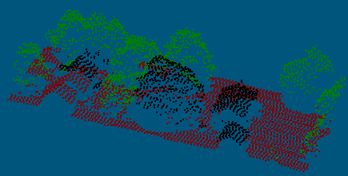
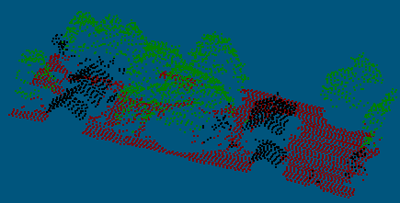
Results
[Munoz et al., 2009]
Our method

Slide 10
Results: balanced loss better than Hamming loss

Slide 11
Results: RBF better than linear

Slide 12
Results: fails at very small classes
0.2% of trainset

Slide 13
Analysis
Advantages:
more flexible model
accounts for class imbalance
allows kernelization
Disadvantages:
really slow (esp. with kernels)
learns small/underrepresented classes badly

